Slide 1
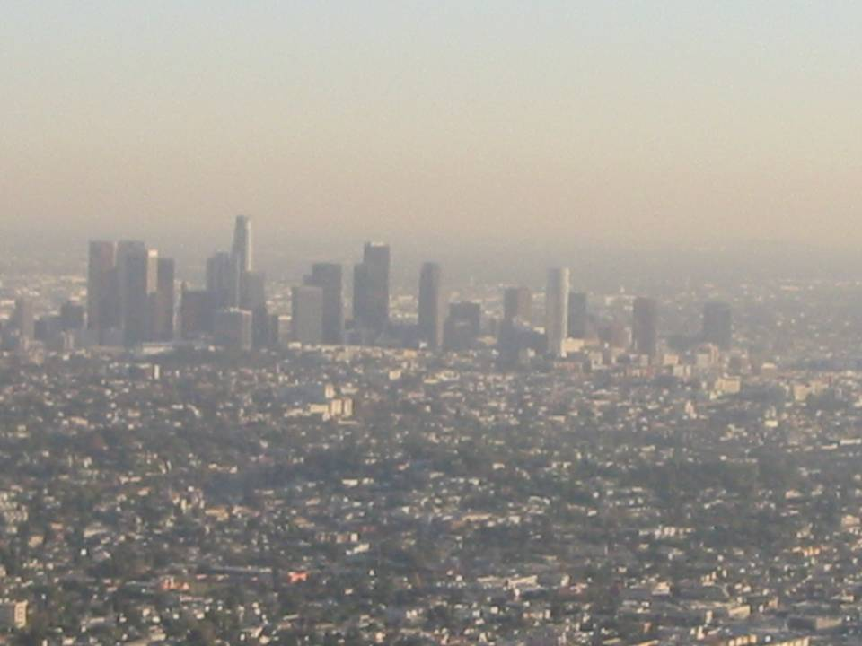
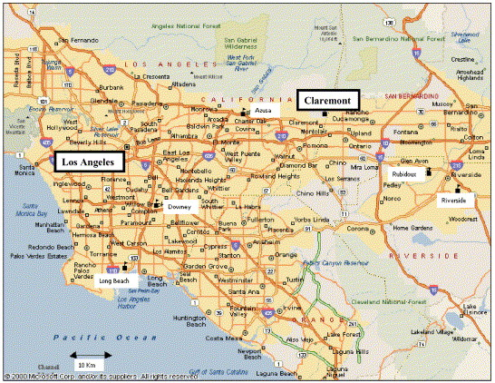
Air Pollution Research in the US Megacity of Los Angeles-
The USC Aerosol Group (www.usc.edu/aerosol )
)
9 million drivers daily
500,000 diesel trucks
5th busiest airport in world
Biggest US harbor (truck traffic, shipments of goods to the entire US)
1 in 18 Americans live here
Arrow shows the prevailing wind direction

Slide 2
Integrated 5-step Approach to Studying Air Pollutants and their Effects
Dispersion , Aging and Transformation in the Atmosphere
(dilution, volatility, PM-gas partitioning, photo oxidation)
Sources
(combustion, power plants, diesel, gasoline, biofuels, wood smoke etc)
Majority of our collaborations with Med Schools
Population Exposure (proximity to freeways, indoor air, temporal and spatial variability of air pollutants)
Health Effects
(In Vitro, In vivo mechanistic studies, Epidemiological studies)
Regulation, Legislation and Policy

Slide 3



Emission Sources of Air Pollutants
Traffic, Freeways, Ports, Power plants
Freshly emitted mixture of non-volatile PM, SVOC (PM and vapor phase), VOC, primary gases
2. Atmospheric Dilution
Phase transformation
Volatilization of primary SVOC and partitioning from PM phase into gas phase
3. Atmospheric Aging and Photo-Chemical Reactions
Photo-chemical reactions of gas phase SVOC with O3 and oxidant gases
Formation of Secondary Organic Aerosol(SOA)
Atmospheric dilution and aging
Secondary aerosol formation
hv +
O₃, HO.
Emissions
Primary particles
Non-volatile PM
Semi-volatile PM species (SVOC)
and Volatile Organics (VOC)
Secondary particles

Slide 4
Haagen Smit Award, Atmospheric Environment, 2012

Slide 5
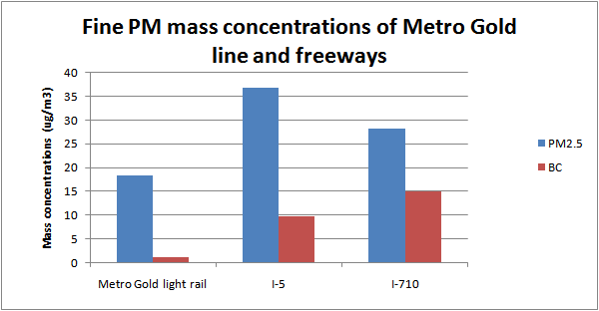
BC
(Kam et al, Atmos. Environ.,2011)
PM2.5 mass (currently regulated) and black carbon (BC) levels in the:
  I-5 (10% heavy duty vehicles), I-710 (20% heavy duty vehicles) and light rail (Gold Line)
Black Carbon (BC) is an indicator of diesel exhaust and used by state and federal agencies for cancer risk to diesel exposure
More than one order of magnitude lower BC levels inside light rail trains

Slide 6
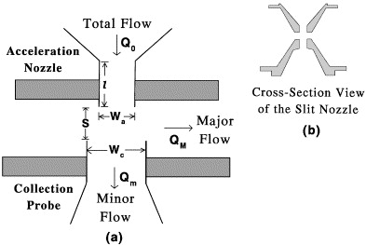
Human Exposure Facility to Concentrated Air Particulates (CAPs)-
USC Versatile Aerosol Concentrators
(VACES)

Slide 7
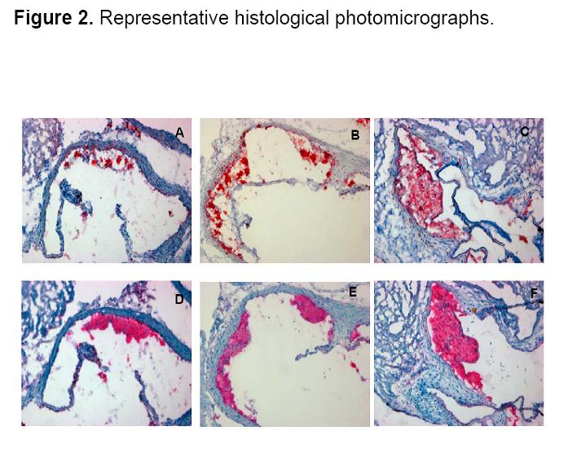
Exposure of Knock-Out Mice to Concentrated Particles (CAPS)
control
Fine PM
Ultrafine PM
Araujo et al, Circulation, 2009
Aortic root sections from Ultrafine PM mice (panels C,F) exhibited greater atherosclerotic lesions than sections from Filtered air (A,D) and Fine PM (B,E) mice.
All lesions primarily consisted of macrophages and can be classified as fatty streaks.

Slide 8

In vivo chronic exposure of mice to ultrafine nanoparticles (nPM) at freeway-like concentrations induced inflammatory responses (associated with premature aging and Alzheimer’s disease)
In cerebral cortex, nPM caused increased mRNA levels of: (a) innate immune receptor CD14 (b) microglial marker CD68, (c) astrocytic marker GFAP-
Morgan et al, Environ Health Perspectives, 2012

Slide 9
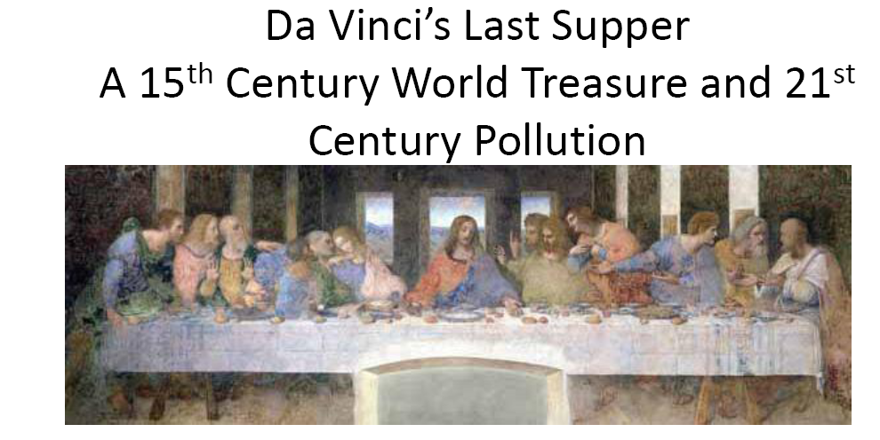
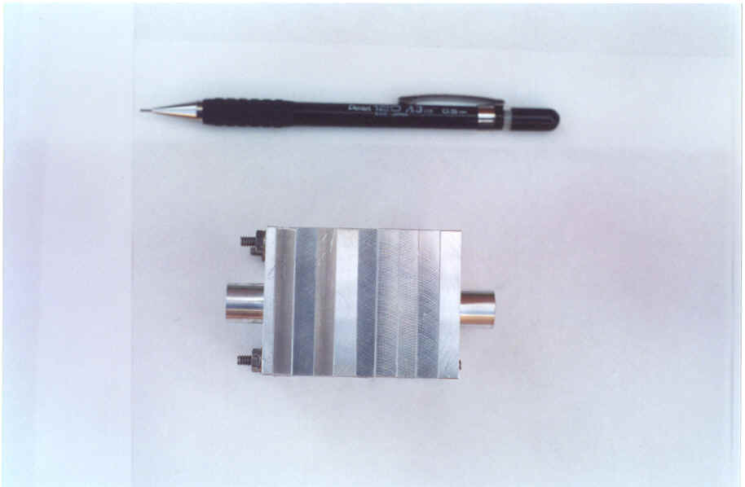
Daher N, Ruprecht A., Invernizzi G., de Marco C., Miller-Schulze J, Heo J.B, Shafer M.M, Schauer J.J, and Sioutas C.* “Chemical Characterization and Source Apportionment of Fine and Coarse Particulate Matter inside the refectory of Santa Maria Delle Grazie Church, home of Leonardo da Vinci’s Last Supper.” Environmental Science and Technology, 45 (24), 10344–1035, 2011
Misra et al., Journal of Aerosol Science, 33(7), 1027-1047, 2002

Slide 10
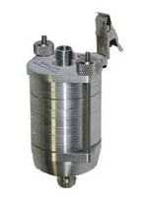
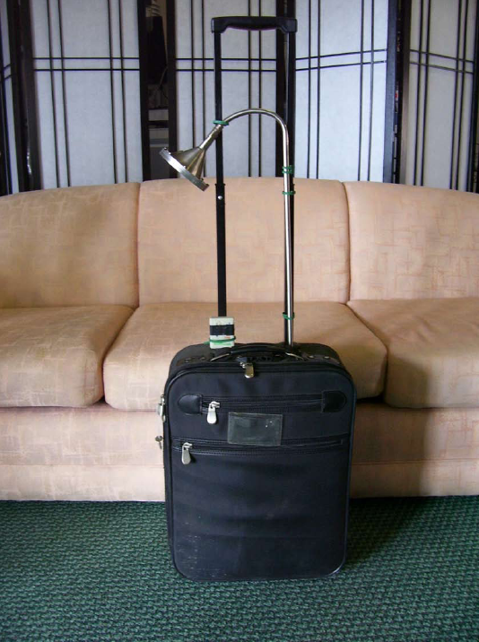
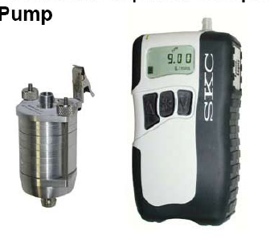
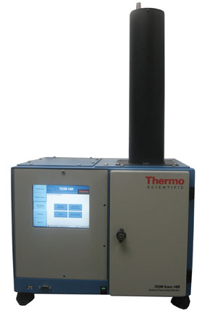
Development of Technologies that became USC patents, licensed to companies and are now commercially available
SioutasTM Personal Cascade Impactor
SKC Inc.
Classification of PM in 5 size ranges (including ultrafine particles) for chemical analysis
1405-D TEOM, Continuous Dichotomous Ambient Particulate Monitor, Thermo Scientific (Thermo electron)
Provides near-continuous mass concentration data for PM2.5 and coarse (2.5-10um) PM

Slide 11
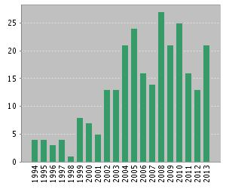
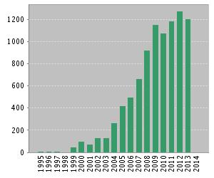

Our Scholastic Contributions
Results found: 262
Sum of the Times Cited : 9,184
Cited without self-citations 7638
Citing Articles : 5171
Citing Articles without self-citations : 4957
Average Citations per Item: 35.80
h-index : 50
Over 260 refereed ISI journal publications
Cited roughly 10,000 times
Google Scholar
Citation indices
All 2008-date
Citations 13086 9487
h-index 57 49
i10-index 180 162

Slide 12
Our Funding Record Since 1998
About $21M in roughly 60 extramural grants (USC Aerosol group portion only)
Agency
Funding in million USD

Slide 13
1. Seongheon Kim, Ph.D., 6/99, Environmental Engineering, USC
(Currently; Associate Professor, Yonsei University Wonju,, Korea)
2. Ming Chih Chang, Ph.D., 3/99, Environmental Engineering, USC
(Currently; Research Scientist, California Air Resources Board)
3. Peter Jaques, Ph.D. 6/97, Environmental Science, New York University
(Currently; Assistant Professor of Environmental Engineering, Clarkson University)
4. Philip M. Fine, Ph.D., 12/01, Environmental Engineering Science, California Institute of Technology
(Currently; Assistant Deputy Executive Officer for Science & Technology Advancement at the South Coast Air Quality Management)
5. Chandan Misra, Ph.D., 3/03, Environmental Engineering, USC
(Currently; senior research scientist, California Air Resources Board)
6. Thomas Kuhn, Ph.D., 9/03, Imperial College (UK)
(Currently; research associate, University of Waterloo, Canada)
7. Manisha Singh, Ph.D., 6/04, Environmental Engineering, USC
(Currently; senior research scientist, California Air Resources Board)
8. Bhabesh Chakrabarti, Ph.D., 2/05, Civil and Environmental Engineering, USC
(Currently; Senior research scientist, Climate Change Division, California Air Resources Board.)
9. Leonidas Ntziachristos, Ph.D., 6/02, Environmental Engineering, Aristotle University of Thessaloniki, Greece
(Currently; Associate Professor, Mechanical Engineering, Aristotle University of Thessaloniki, Greece.)
10. Michel D. Geller, Ph.D., 8/03, Environmental Engineering, USC
(Currently; senior scientist, US Environmental Protection Agency)
11. Harish Phuleria, Ph.D., 6/07, Environmental Engineering, USC
(Currently: Assistant Professor, IIT Bombay, India)
12. Markus Sillanpää, Ph.D. 10/06, Environmental Engineering, University of Helsinki, Finland; (Currently; research assistant professor, University of Helsinki, Finland)
13. Shaohua Hu, Ph.D., 7/06, Civil and Environmental Engineering, University of Washington- Saint Louis; (Currently; senior research scientist, California Air Resources Board)
14. Margaret Krudysz Ph.D. 12/07, Environmental Health, UCLA
(Currently; undergraduate program director, Earth System Science & Environmental Engineering, City College of New York)
15. Andrea Polidori, Ph.D., 6/05, Environmental Engineering, Rutgers University
(Currently, senior manager, South Coast Air Quality Management District)

Slide 14
16. Bangwoo Han, Ph.D. 11/06, Chemical Engineering, Hiroshima University, Higashi-Hiroshima, Japan
(Currently, senior research scientist, Korean Institute of Mining and Manufacturing)
17. Mari Cruz Minguillon- Bengochea, Ph.D. 07/07, University Jaume I of Castellón School of Technology and Experimental Sciences, Barcelona, Spain
(Currently; senior research staff, Paul Scherrer Institute, Switzerland)
18. Katharine Moore, Ph.D., 3/02, Civil and Environmental Engineering, University of Colorado
(Currently, Science and Technology Policy Fellow, California Council on Science and Technology)
19. Subhasis Biswas, Ph.D., 1/08, Environmental Engineering, USC
(Currently; senior research scientist, California Air Resources Board)
20. Mohammad Arhami, PhD, 7/09, Environmental Engineering, USC
(currently, Assistant Professor,,Civil & Environmental Engineering, Shariff University, Iran)
21. Ajay Kumar Chaudhary Ph.D., 12/08, Chemical and Environmental Engineering, University of California- Riverside. (Currently; research scientist, California Air Resources Board)
22. Vishal Verma, PhD, 7/11 Environmental Engineering, USC
(currently, senior research fellow, Georgia Tech)
23. Evangelia Kostenidou, PhD., 5/10, Chemical Engineering, University of Patras, Greece
(Currently; research associate, University of Patras, Greece)
24. Zhi Ning, PhD, 5/09 Environmental Engineering, USC
(Currently: assistant professor, Civil & Environmental Engineering, City University of Hong Kong)
25. Payam Pakbin, PhD, 7/11 Environmental Engineering, USC
(Currently; research scientist, South Coast Air Quality Management District)
26. Nancy Daher, PhD, 8/13, Environmental Engineering, USC
(Currently; research associate, USC)
Neelakshi Hudda, PhD, 5/12, Environmental Engineering, USC
(currently Research Associate, USC Keck School of Medicine)
26. Kalam Cheung, PhD, 5/12, Environmental Engineering, USC
(currently, senior research fellow, Hong Kong Polytechnic)
Winnie Kam, PhD, 2/13 Environmental Engineering, USC
(currently, research scientist, Cal EPA)

Slide 15
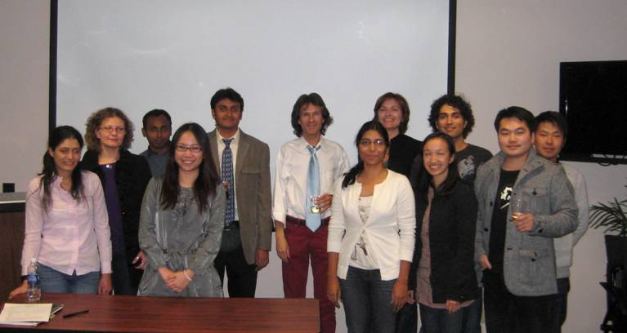
Our Group and Alumni (photo in late 2011)
26 PhD students (23 completed PhD dissertations so far)
25 post docs (4 of whom research faculty at CEE / VSOE)
Placement of our Alumni:
6 faculty (IIT Mumbai, Sharif, KIST, Hong Kong, Aristotle Univ Greece, Clarkson Univ.)
Regulatory Agencies: 3 at AQMD, 8 at CARB, 2 at USEPA
International : KIIM, Finn. Met. Inst, Spanish Nat Res Council, Paul Scherrer Inst., U Patras

