Slide 1
Development of novel techniques for evaluating chemical and toxicological properties of particulate matter (PM) in ambient air
Constantinos Sioutas, ScD
Fred Champion Professor
Civil and Environmental Engineering
University of Southern California
3620 South Vermont Avenue
Los Angeles, CA 90089
USC Aerosol Group: www.usc.edu/aerosol

Slide 2
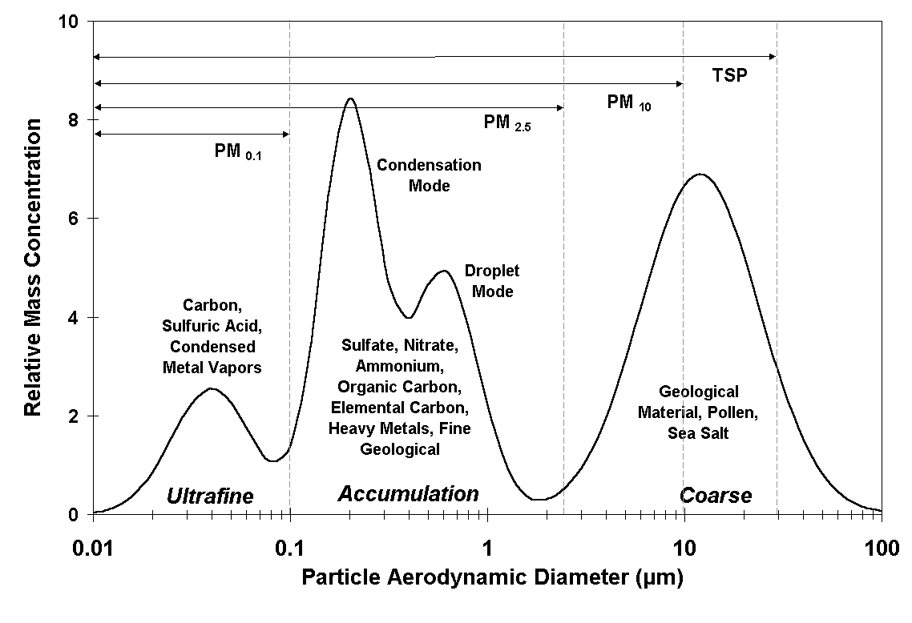
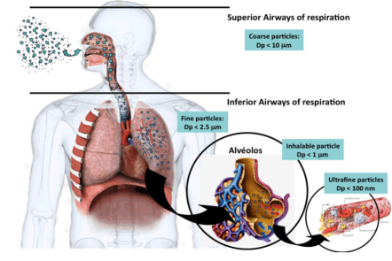
Background: PM Definition
1) Sulfur dioxide
2) Nitrogen oxides
3) Ozone
4) Carbon monoxide
5) Lead
6) Particulate Matter
Criteria Air Pollutants (US-EPA):
Solid or liquid particles suspended in air
Ultrafine Fine or PM2.5 Coarse
< 0.1 µm
0.1-2.5 µm
2.5-10 µm
Source: Central Pollution Control Board, http://www.cpcb.nic.in
Guarieiro et al., InTech, (2013)

Slide 3
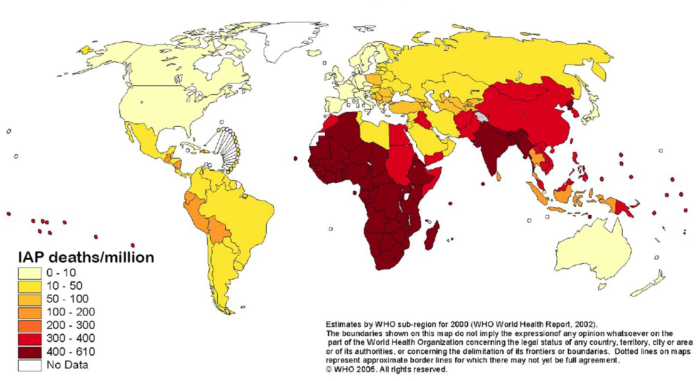
Background: Air Pollution and Mortality
Ambient (outdoor air pollution) was estimated to cause 3.7 million premature deaths worldwide in 2012. (source: WHO)

Slide 4
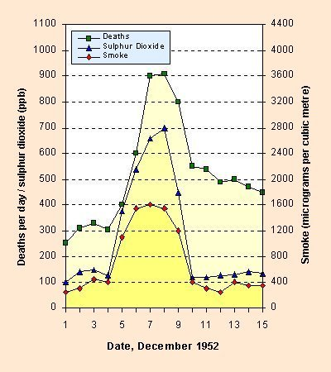
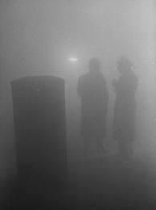
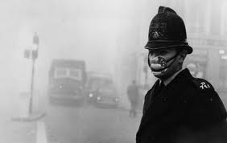
The London Smog Episode in the winter of 1952

Slide 5
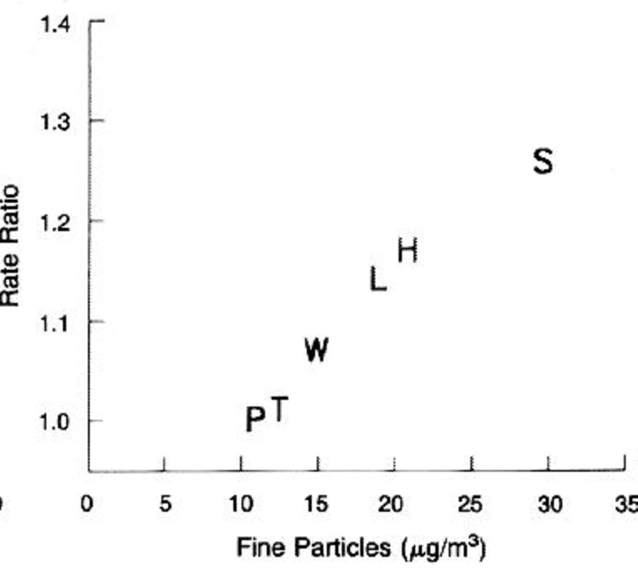
PM Background – Health Effects
Harvard six-city Study
Cohort study of adults followed for 14-16 years
Associated with lung cancer and cardio-pulmonary disease
Strongest assoc. with fine PM
P = Portage, Wisconsin; T = Topeka, Kansas; W = Watertown, Massachusetts; L = St. Louis; H = Harriman, Tennessee; and S = Steubenville, Ohio
AN ASSOCIATION BETWEEN AIR-POLLUTION AND MORTALITY IN 6 UNITED-STATES CITIES
DOCKERY DW, POPE CA, XU XP, SPENGLER JD, WARE JH, FAY ME, FERRIS BG, SPEIZER FE
NEW ENGLAND JOURNAL OF MEDICINE 329 (24): 1753-1759 DEC 9 1993

Slide 6
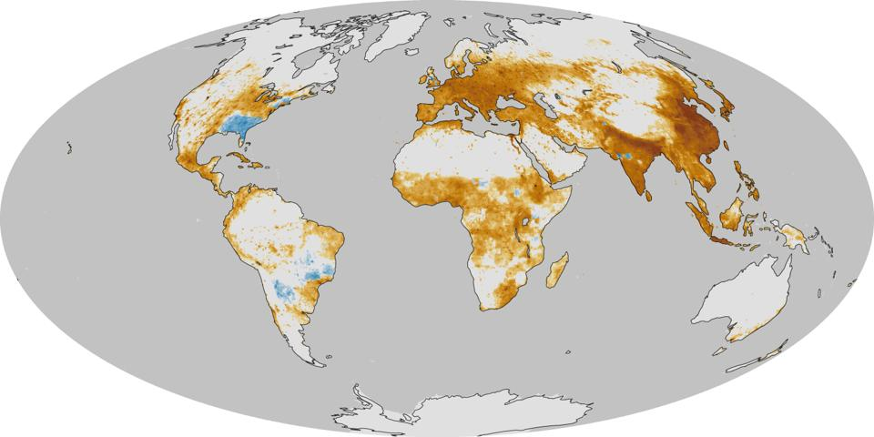
The Global Toll of Fine Particulate Matter- Excess Mortality per year per 100 km²
Source: NASA http://earthobservatory.nasa.gov/IOTD/view.php?id=82087&eocn=home&eoci=iotd_title

Slide 7
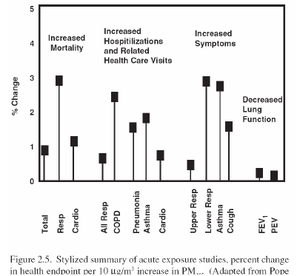
Epidemiological studies show that PM:
affects cardiorespiratory system
can cause cancer
impairs lung development
Impairs neural system
[NARSTO, 2003]
The EPA estimates that over 60,000 premature deaths per year in the US can be attributed to PM. More deadly than car accidents!

Slide 8
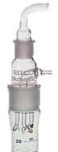
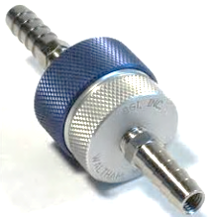
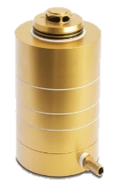
Traditional Methods for PM Characterization.
Traditional PM sampling methodologies usually involve collection of particles onto substrates by filtration or inertial impaction
Collected particles are extracted using different types of solvents (e.g., water, methanol, etc) and analyzed by various analytical techniques (IC, ICP-MS) and total organic carbon (TOC) analysis
Biosampler
(Liquid impingement)
SKC Inc. Eighty Four, PA
Nano-MOUDI
(Impaction)
MSP Corporation, Shoreview, MN
Filter
(Filtration)
cell-free DTT assay
Macrophage ROS
Toxicological properties
total and water soluble metals
OC, water soluble OC
Inorganic ions
Chemical constituents
Gravimetric mass;
Notes:
Filter image to be added + fine tuning

Slide 9
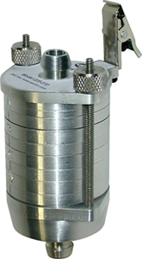
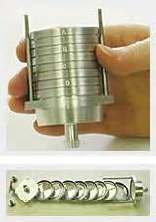
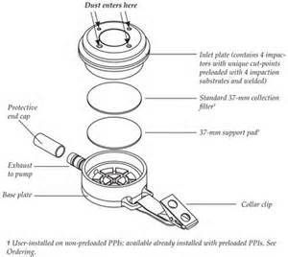
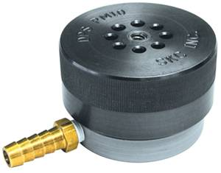
Impactor
Filter Sampler

Slide 10
Filter or Impaction Substrate
Extract with:
Ultrapure deionized (milli Q ) water
  (for ion chromatography- ammonium, nitrate and sulfate ions)
Mixture of milli Q water and 1% HNO3 (for measurement of trace elements and metals)
Organic Solvents (xylene etc) for HPLC to measure organics

Slide 11
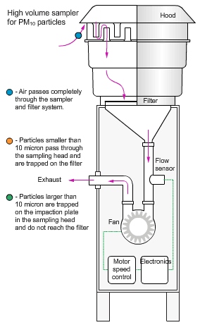
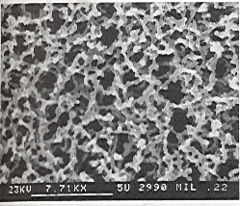
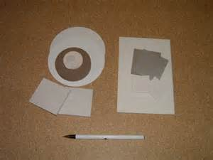
High Volume PM10 filter sampler
Source; Queensland Government
Porous
membrane
Filter

Slide 13
Schematic of an Impactor
Aerosol Inlet
Acceleration Nozzle
Air Flow
Air Flow
Collection
Substrate

Slide 14
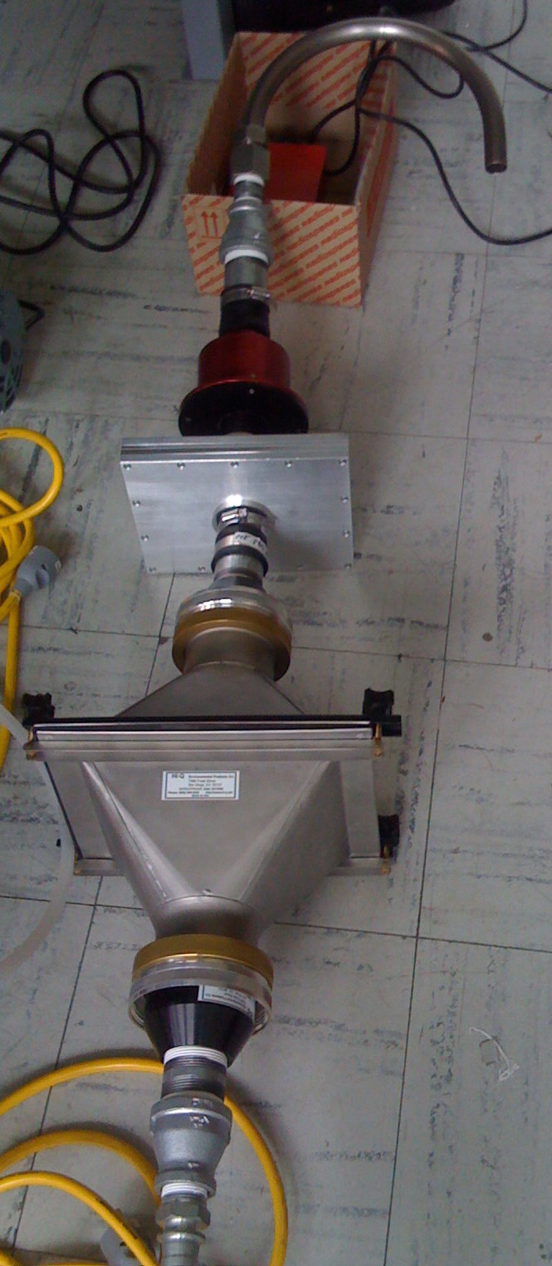
PM₁₀ Inlet
PM_{2.5} impactor
Inlet air
(400 LPM)
UF slit impactor
Filter holder (8”X10”)

Slide 15
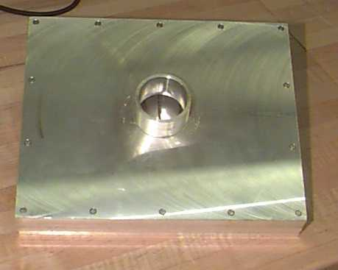
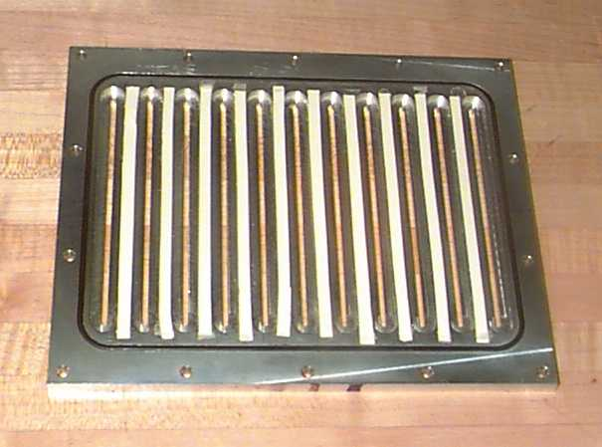
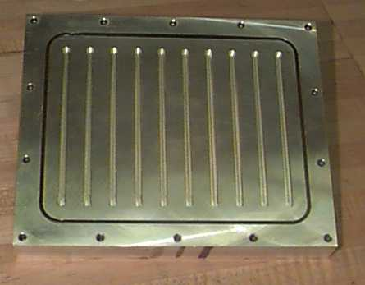
High-Volume, Very Low Pressure Drop Impactor for Separation of Coarse-Fine-Ultrafine PM
Misra et al Journal of Aerosol Science, 33(5): 735-752, 2002

Slide 16
ACCELERATION AND CURVILINEAR PARTICLE MOTION
The Stokes number St:
Collection efficiency is governed by St, which for an impactor is defined as the ratio of the particle stopping distance at the average nozzle exit velocity (U) to the nozzle (jet) radius (D_{j}/2)
The efficiency curves of well-designed impactors are characterized by a St₅₀ (i.e. Stoke number that gives 50% collection efficiency)
E = Δ / (D_{j}/2)= ( π τ U) / D_{j} = π St
St₅₀ = 0.5/3.14 = 0.17≈ 0.20
50%
d₅₀ = cut-off size= 0.15 µm

Slide 17
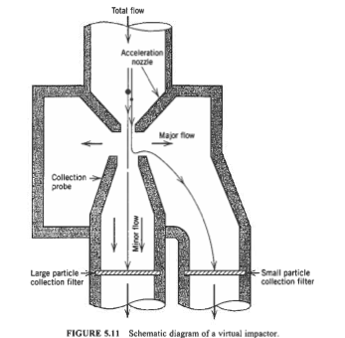
ACCELERATION AND CURVILINEAR PARTICLE MOTION
Virtual Impactors
Designed to collect a larger particulate mass than is possible with conventional impactors
Main and secondary flows. Secondary flow is 5-10% of the main flow and will include 5-10% of particles smaller than the stage cut-off size
The greater the secondary flow the sharper the cut-off and the greater the fraction of small particles that will be trapped on the filter

Slide 18
Motivation, Rationale and Objectives
Drawbacks:
  Long turn-around time for processed results
  Long sampling intervals for collection of sufficient mass for subsequent chemical analysis
  Incomplete extraction of insoluble PM-bound species
  Potential sampling artifacts (e.g., losses of labile species such as ammonium nitrate and semi-volatile organic carbon (SVOC))
  Changes in chemical speciation (e.g. oxidation state shifts in redox active metals)

Slide 19
Advanced aerosol sampling technologies were developed in recent years to overcome these limitations (PILS etc)
Most of these technologies are inadequate for the measurement of trace level species such as metals and trace elements due to their low signal-to-noise ratio.
VACES/ Biosampler:
Versatile aerosol concentration enrichment system (VACES) (Kim et al. 2001b; Kim et al. 2001a) in tandem with a liquid impinger PM collector (BioSampler, SKC West, Inc., Fullerton, CA) concentrates both fine and ultrafine particles into an aqueous suspension.

Slide 20
Versatile Aerosol Concentration System (VACES) Schematic

Slide 22
Droplet Sizes vs Initial Particle Size

Slide 23
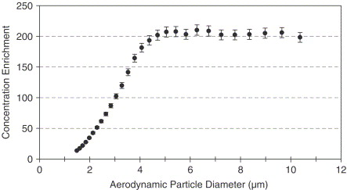
By itself, virtual Impactor is a coarse particle concentrator (Chang et al , 2002, Aerosol Science and Technology 36 (4), pp. 492-501

Slide 24
VACES/BioSampler tandem
Saarikoski, S. at al, AMT, 2014

Slide 25
VACES/ Biosampler vs Impactors and Filters
Gravimetric mass concentration comparison
Set-to-set variability but consistent for all samplers
Very good agreement among methods indicating efficient PM mass collection by all samplers.

Slide 26
Inorganic composition: mean concentrations
Good agreement on inorganic ions among all samplers. Same PM recovery by IC analysis on water soluble particles from substrates.
Enriched particle mass concentration at low sampling flow rates from VACES reduced positive and negative artifacts for filter sampling. ( see also Chang et al Atmos Environ34:86-98, 2000)
Notes:
CHLORIDE!!!

Slide 27
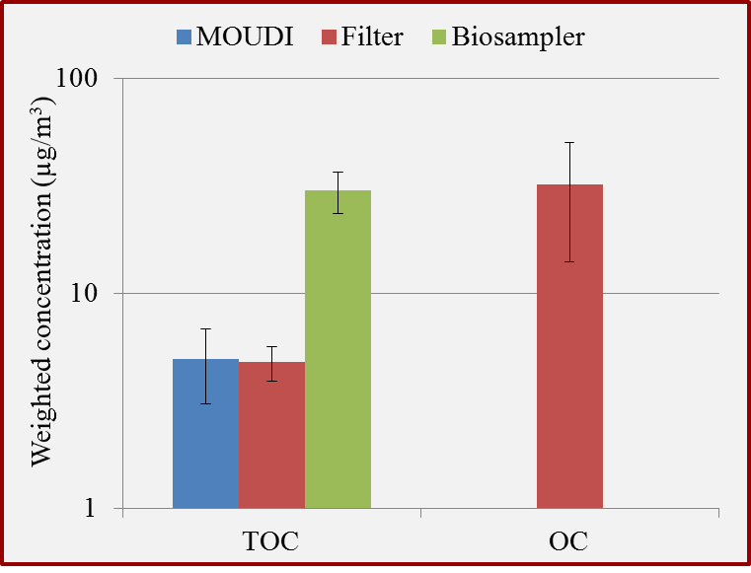
Organic carbon: average concentrations
Excellent agreement on water soluble organic carbon (TOC) between water extracted MOUDI substrates and filter samples;
TOC in BioSampler much higher than the other two;
However, very good agreement between levels of TOC level of BioSampler slurry and OC of filter;
Recovery of both soluble and insoluble OC from VACES+biosampler method.

Slide 28
Results and discussion
Water soluble metals and elements
The profiles of water soluble metals agree very well with each other.

Slide 29
Major Advantage of VACES/BioSampler :capture of Reactive Oxygen Species (ROS) from both water soluble and insoluble PM (Daher et al, AS&T 2011)
VACES/BioSampler
VACES/BioSampler after filtering slurry to remove insoluble PM

Slide 30
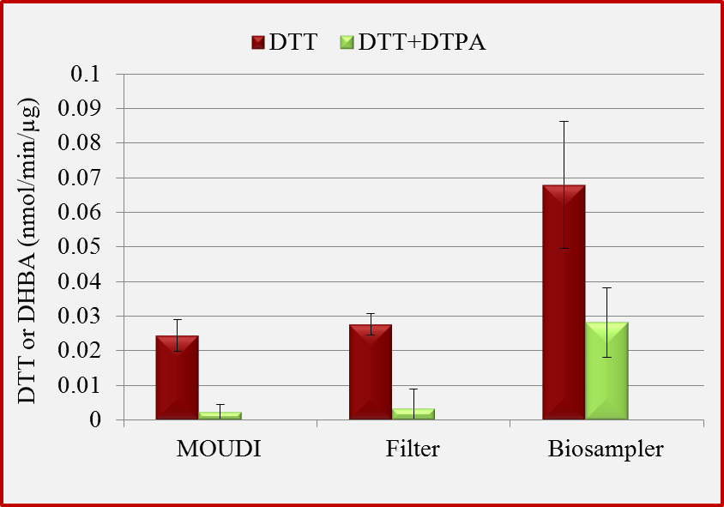
Toxicity assays: DTT and DHBA
DTT activities are similar b/t filter and MOUDI water extracts, reflecting their agreement of water soluble OC and metals.
Significantly higher BioSampler DTT activity indicates that PM-bound organics and/or metals also significantly contribute to the overall activity.
With addition of metal chelator DTPA, DTT activity decreased by 90% for both MOUDI and filter samples; and 60% for BioSampler;
Remaining activity shows very good agreement with the TOC mass ratios in total PM mass, indicating the contribution of OC in DTT activity;
 | DTT+DTPA | mass ratio
 | (nmole DTT/min/µg) | (TOC/total PM)
Filter | 0.003 | 4.0%
MOUDI | 0.002 | 3.5%
Biosampler | 0.028 | 26.4%

Slide 31
Applications of the VACES:
Increase Sensitivity of On Line Continuous PM Monitors:
VACES / photoionization aerosol mass spectrometer – Univ Delaware (prof Murray Johnston -Aerosol Science and Technology 42 (1), pp. 18-27)
Max Planck Institute – (Online atmospheric pressure chemical ionization ion trap mass spectrometry (APCI-IT-MSn) for measuring organic acids in concentrated bulk aerosol – Vogel et al, Atmospheric Measurement Techniques 6 (2), pp. 431-443
VACES/ AMS – (Evaluation of the performance of a particle concentrator for online instrumentation, Saarikoski et al, Atmospheric Measurement Techniques 7 (7), pp. 2121-2135
VACES AMS- In situ concentration of semi-volatile aerosol using water-condensation technology – Khlystov et al 2005Journal of Aerosol Science 36 (7), pp. 866-880

Slide 32
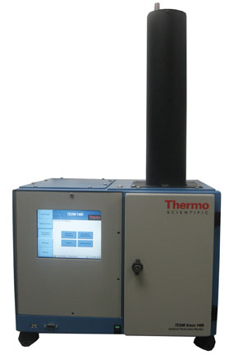
Univ of Vienna- Optical CCN studies- Prof Regina Hitzenberger
FRM Continuous Monitor of Coarse and Fine PM
1405-D TEOM, Continuous Dichotomous Ambient Particulate Monitor, Thermo Scientific (Thermo electron)
Provides near-continuous mass concentration data for PM2.5 and coarse (2.5-10um) PM
PM2.5
Coarse (PM_{2.5-10} )
TEOM

Slide 33
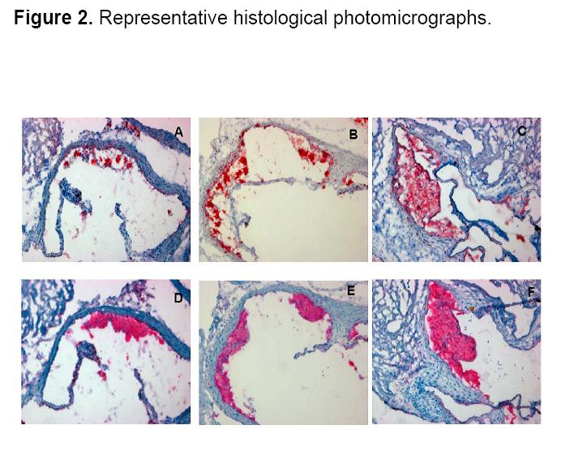
Exposure of Knock-Out Mice to Concentrated Particles (CAPS)
control
Fine PM
Ultrafine PM
Araujo et al, Circulation, 2008
Aortic root sections from UFP mice (C,F) exhibited greater atherosclerotic lesions than sections from Filtered air (A,D) and Fine PM (B,E) mice.
All lesions primarily consisted of macrophages and can be classified as fatty streaks.

Slide 34
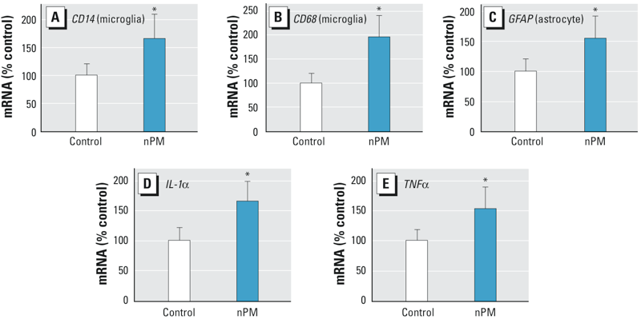
In vivo chronic exposure of mice to ultrafine nanoparticles (nPM) at freeway-like concentrations induced inflammatory responses in their cerebral cortex (associated with premature aging and Alzheimer’s disease)
Morgan et al, Environ Health, Perspect 2011

Slide 35

Conditioned medium (CM) from nPM-treated mixed glia (10 μg/mL nPM, 24 hr) inhibited neurite outgrowth by 30% and decreased the number of neurites by 25%
• Embryonic neurons involved in development of learning and memory
Morgan et al , EHP, 2011

Slide 36
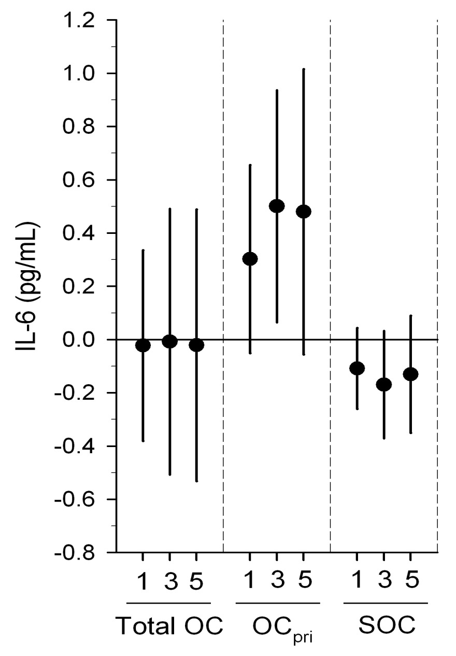
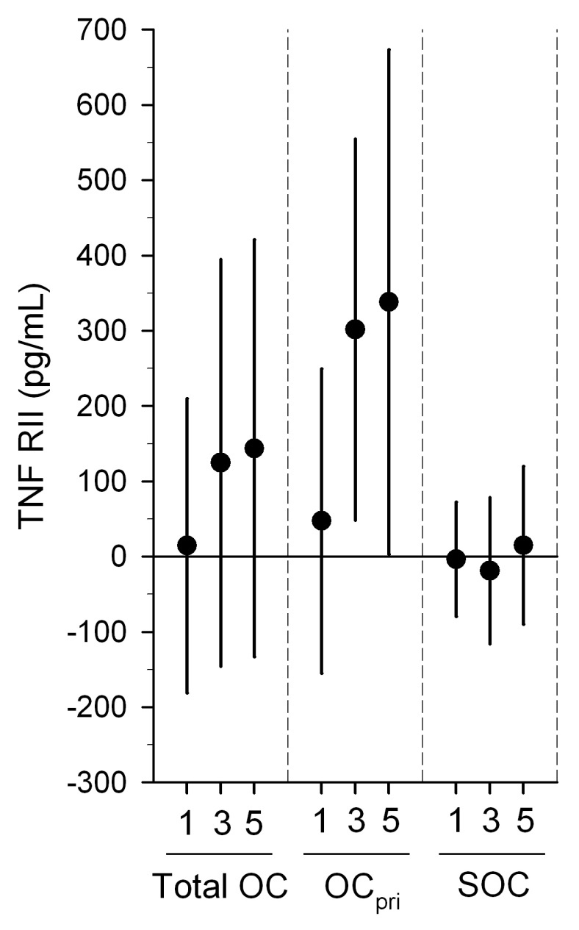
Associations of biomarkers of systemic inflammation
per interquartile increase in outdoor organic carbon (OC):
differences by primary OC (OC_{pri}) & secondary OC (SOC) fractions.
1-day, 3-day and 5-day averages of air pollutants
Delfino et al, Epidemiology 2010

Slide 37
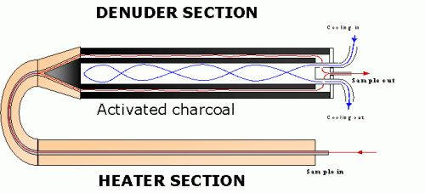
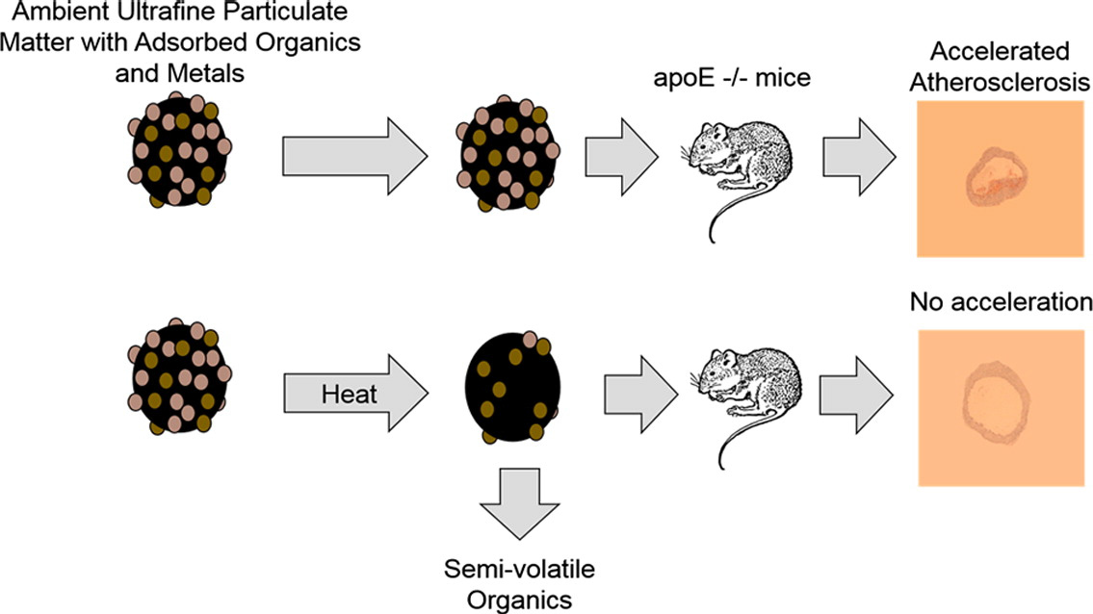
Animal Exposure chamber
VACES
Animal Exposure chamber
Thermo-denuder

Slide 38
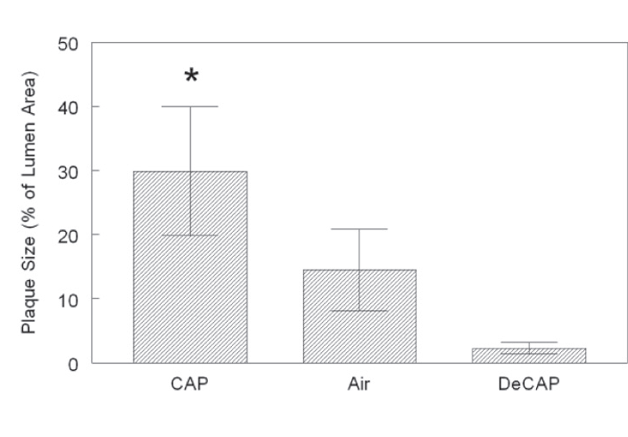
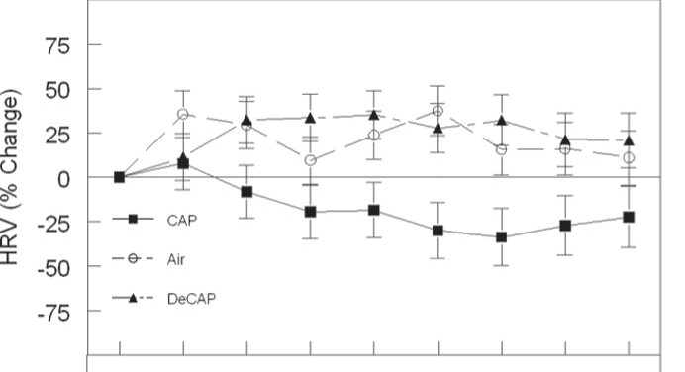
Development of atherosclerotic plaque
Change in Hearth Rate Variability (HRV) as a function of time (from 0 to week 10)

Slide 39
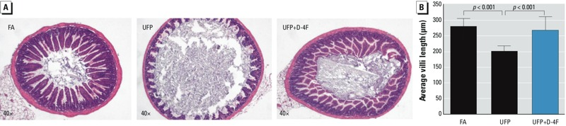
Exposure to ambient UFP (diameter < 180 nm) increased free fatty acids and lipid metabolites in the mouse small intestine.
Villous morphological change in response to UFP exposure.
(A) Cross-sections of mice ileum in response to FA, UFP, and UFP+D-4F were stained with H&E.
(B) The villi of small intestine from UFP exposed mice were significantly shortened (p < 0.001, n = 4).
D-4F administration significantly attenuated UFP reduction on villous lengths (p < 0.001, n = 4).
Notes:
dministration of D-4F, an apolipoprotein A-I (ApoA-I) mimetic peptide, attenuated UFP-modulated lipid metabolism and atherosclerosis (Li et al. 2013), which is consistent with studies demonstrating that D-4F restored HDL function and attenuated atherosclerosis

Slide 40
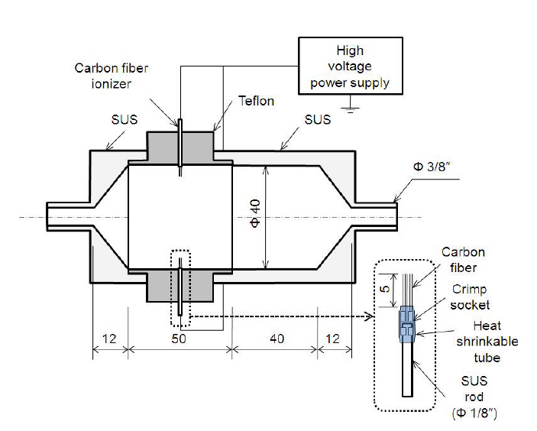
Concept of a Highly Charged Aerosol Using the VACES and Novel Carbon Nano-fiber Charger (Han B. Kim H.J., Kim Y.J. and Sioutas C. “Unipolar Charging of Ultra-fine Aerosol Particles Using Carbon Fiber Ionizers.” Aerosol Science and Technology, 42:793–800, 2008.)

Slide 41
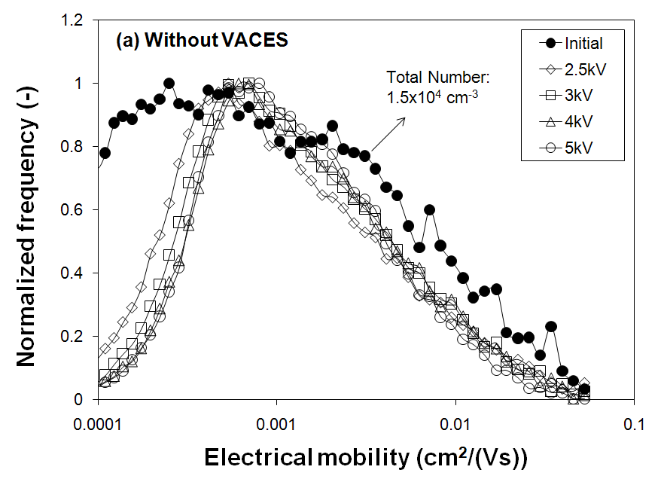
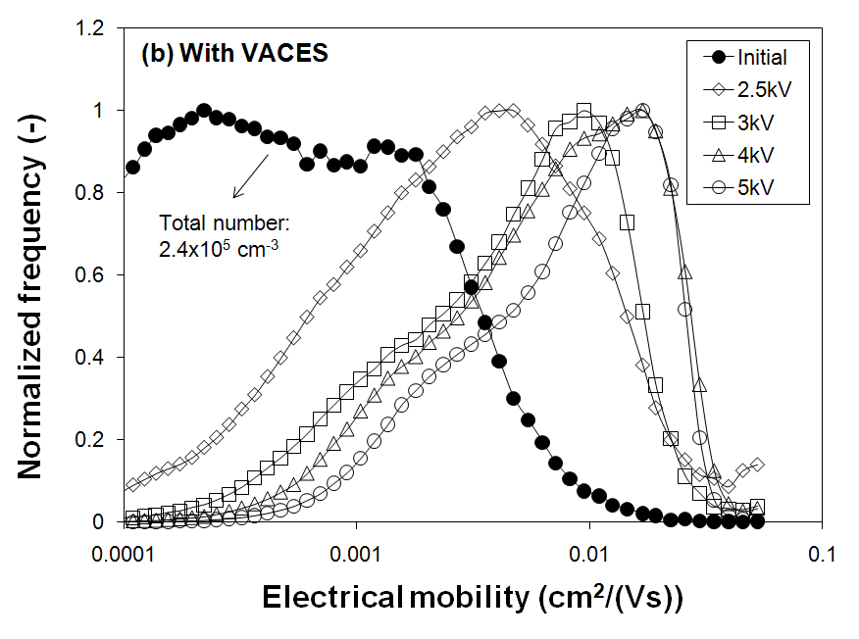
Electrical Mobility distributions of charged particles
(a) without
and
(b) with the VACES
~ 30 fold increase in electrical mobility

Slide 42
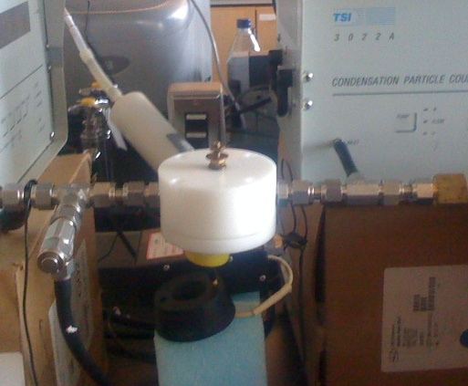
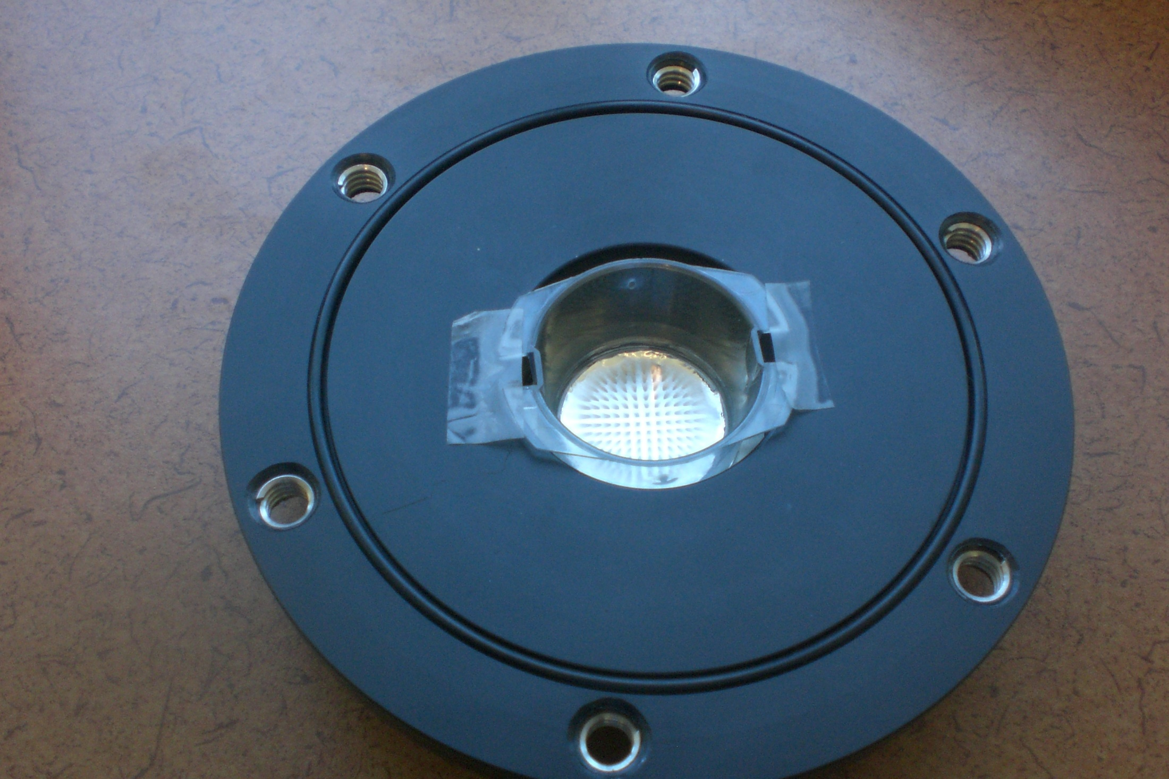
Han B., Hudda, N., Ning Z., and Sioutas C.* “Efficient Collection of Atmospheric Aerosols with a Particle Concentrator—Electrostatic Precipitator Sampler “. Aerosol Science and Technology, 43:757–766, 2009.

Slide 43
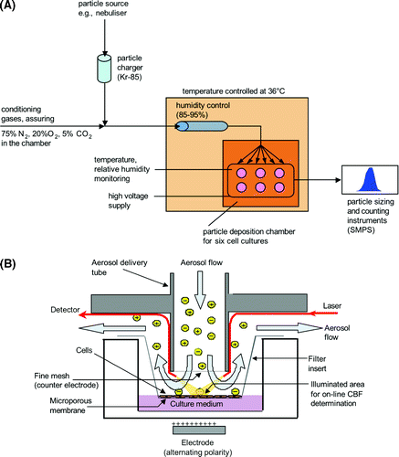
VACES
Ambient or lab-generated test aerosols
Use of VACES in Conjunction with Novel Exposure System for Controlled Deposition of Aerosol Particles onto Cell Cultures
( Kalberer et al EST,2006)
Also Geiser et al, Nature Biology, 2015

Slide 44
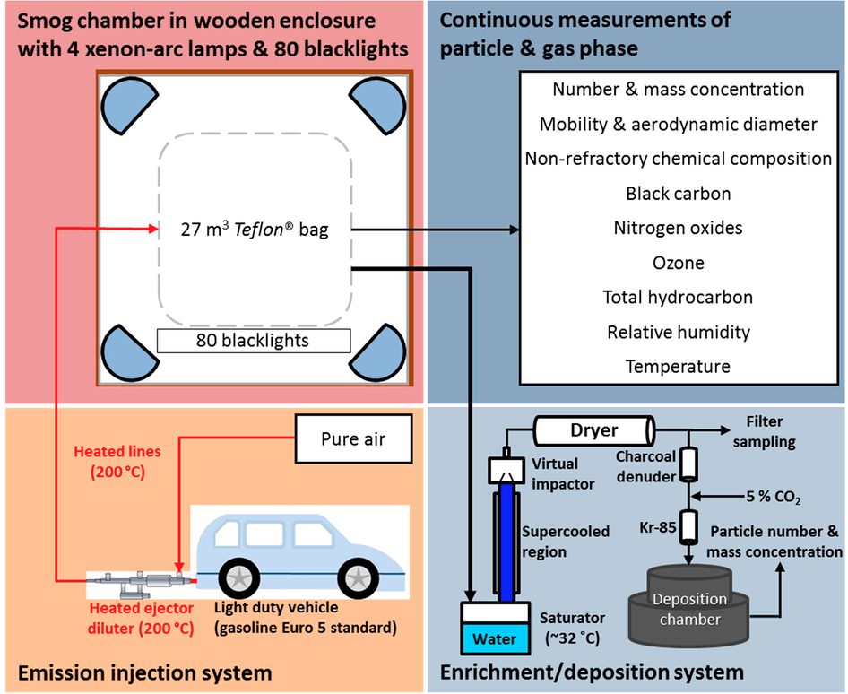

Slide 45
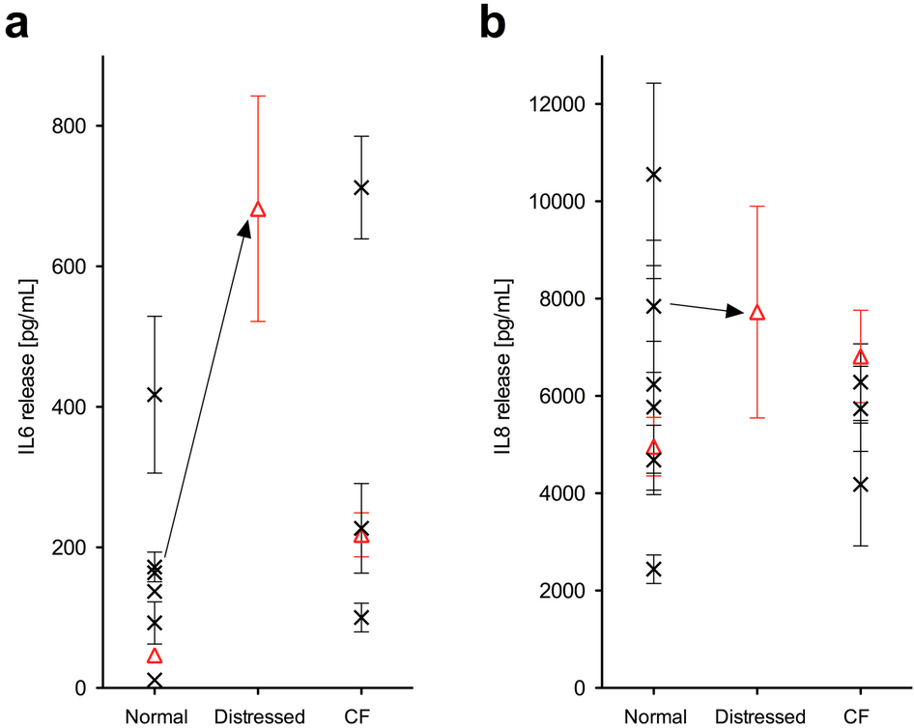
Basolateral release of interleukin (IL)-6 cultures of 7 normal and 4 CF donors into the culture medium during 24 h, presented as mean of triplicate cell cultures ± standard error (s.e.m.) for each donor.
The 3 donors used in the present study are shown as red triangles.
Distressing donor cells by antibiotics treatment during differentiation resulted in increased baseline release of IL-6.
HBE cells: human bronchial epithelial cells; CF: cystic fibrosis.

Slide 46
VACES/ BIOSAMPLER DRAWBACKS
  Excess water accumulation and clogging of the virtual impactor acceleration and collection nozzles
  Operation requires some field supervision , which limits its unattended operation in long periods of time.

Slide 47
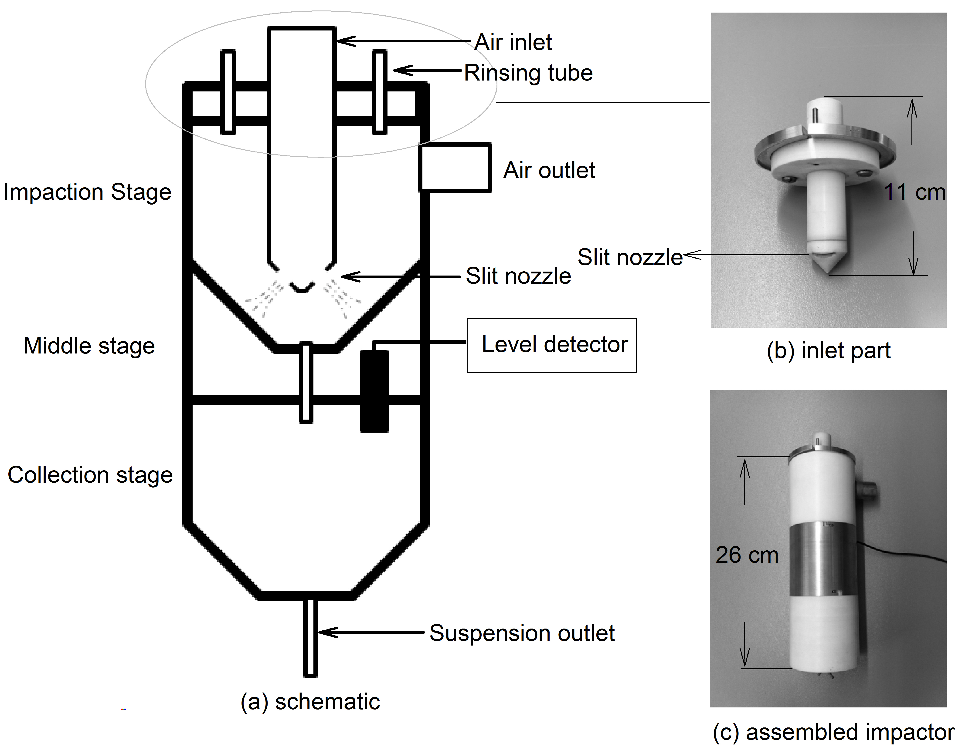
Design of the New Impactor Sampler Replacing the Virtual Impactor of the VACES- Sampling flow 200 lpm
Figure 1 Schematic of impactor

Slide 48
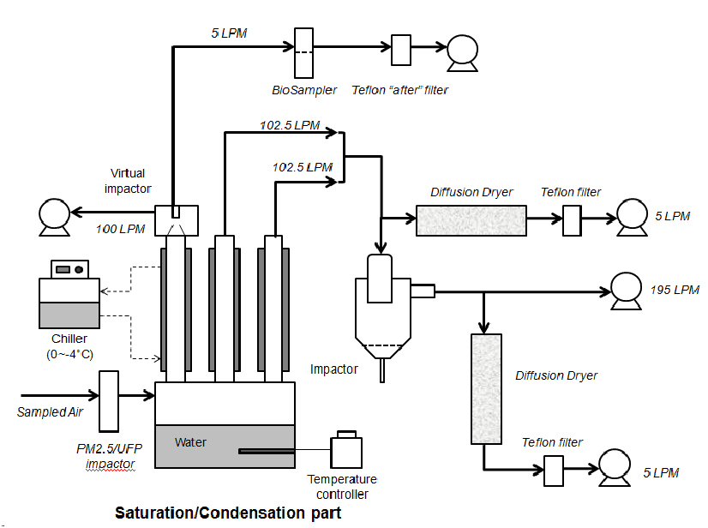
VACES
Components
New impactor
Figure 2 System schematic for collection efficiency tests

Slide 49
TABLE 1 Collection efficiency of PSL particles and Black Carbon (BC)
Collection Inlet Wall Fraction collected
Particle efficiency loss loss in suspension
PSL 42.5 nm 96.4% 4.5% 9.4% 82.4%
PSL 100 nm 90.3% 2.1% 7.5% 80.7%
PSL 300 nm 98.9% 1.1% 6.2% 91.4%
PSL 750 nm 95.1% 2.8% 8.1% 84.1%
PSL 1 μm 99.1% 1.7% 9.3% 88.0%
Ambient BC 94.3% – – –

Slide 50
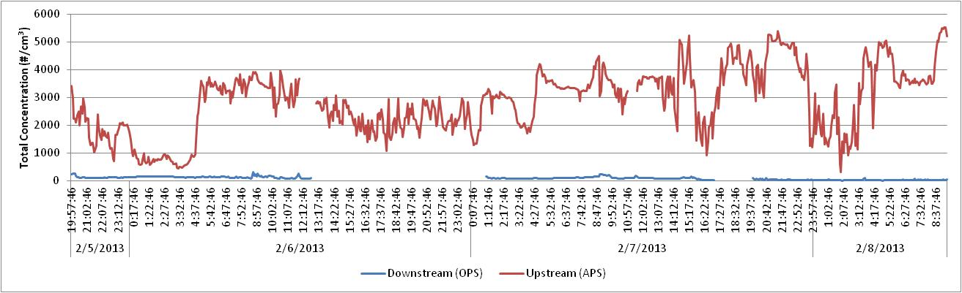
Field evaluation
Continuity tests/ Unattended Sampling
Ambient PM at USC were continuously collected over 48-72 hrs period
Number based collection efficiency = 98.8%
Gaps in OPS data due to software malfunction.

Slide 51
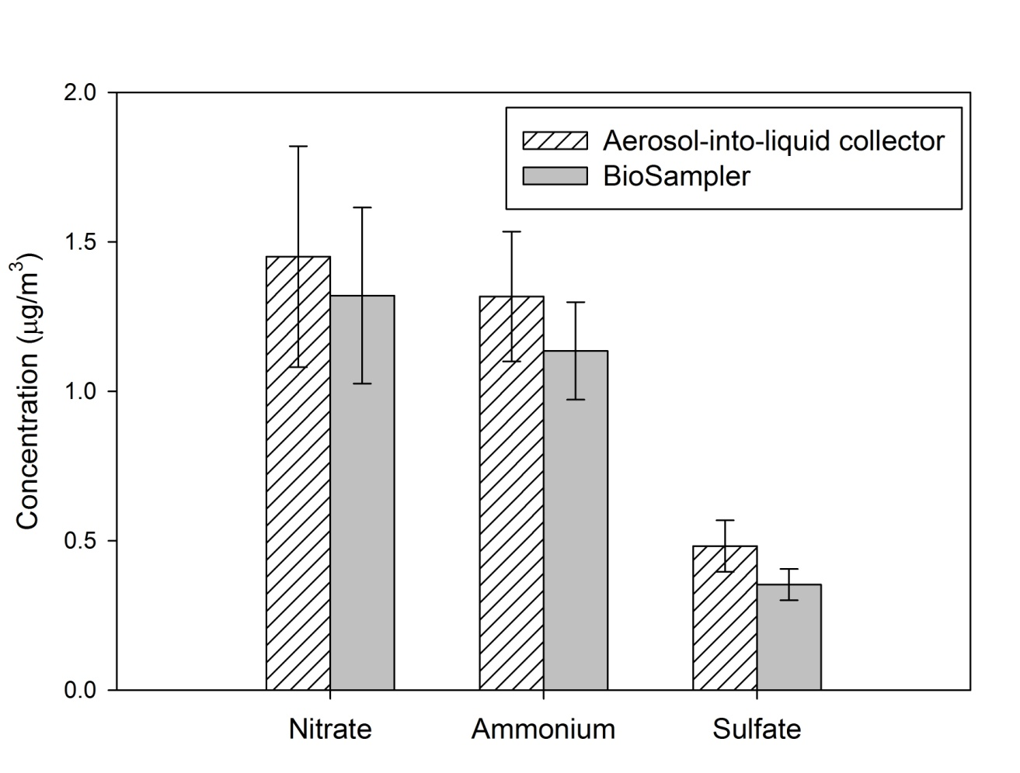
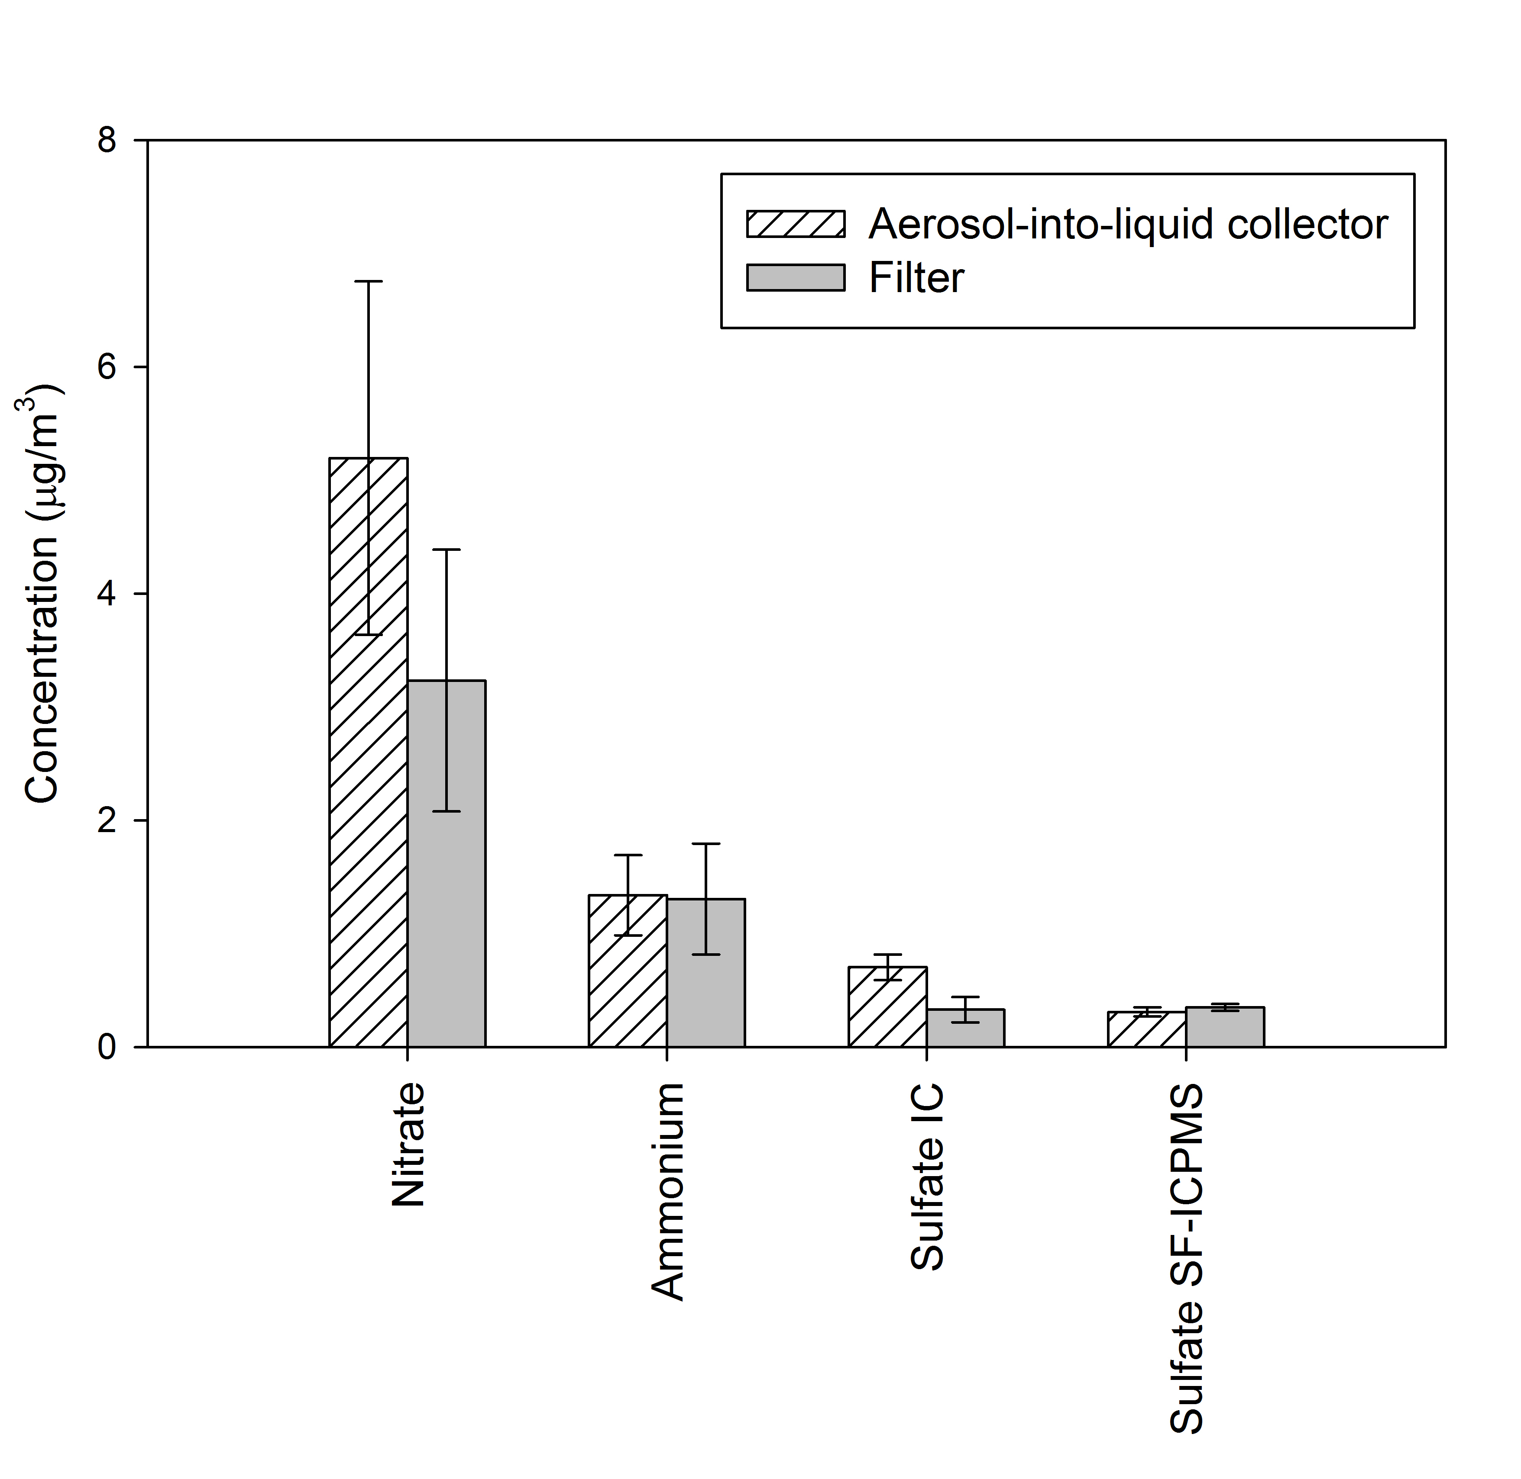
Very similar nitrate, sulfate and ammonium concentrations between Biosampler and Impactor
Similar sulfate and ammonium between filter and impactors
Higher by 35% nitrate levels in on line sampler compared to filter

Slide 52

TOC
WSOC
Similar Total Organic Carbon (TOC) and Water Soluble Organic Carbon (WSOC) levels between BioSampler and impactor

Slide 53

Metals and Trace Elements- Impactor vs Filter
Average impactor vs filter concentration ratio : 1.18 ± 0.41
(excluding Ca, Cr and Ni brings the average ratios to 0.95 ± 0.18).

Slide 54
PM Chemistry and Toxicity
Size | Species that correlated with ROS | Location | Author & Year
PM_{2.5} | WSOC, Cr, Cu, Fe | Urban (Milan, Italy) | Daher et al., 2012
PM_{2.5-10} | WS Cu | Urban (LA, CA) | Cheung et al., 2011
PM_{2.5} | WS Fe, WS Cr | Urban (LA, CA) | Verma et al., 2009
PM₁₀, PM_{2.5} | WS Mn, WS Fe | Urban (Lahore, Pakistan) | Shafer et al., 2010
PM_{2.5-10}, PM_{0.25-2.5}, PM_{0.25} | OC, WSOC, PAHs (MW≤228) | Industrial/urban (Long Beach/ LA, CA) | Hu et al. ,2008
Ambient PM measurement in high time resolution becomes critical to identify the toxicologically relevant PM species, as well as the sources of these species.

Slide 55

Use of the On line sampler for near- continuous measurement of toxic metals
Ion Selective Electrodes (ISE)
Ion Selective Electrodes (ISEs) are routinely used for determining the concentration (technically the activity) of selected ions in aqueous solutions.
Relatively inexpensive, simple to use, and mostly function linearly over many orders of magnitude of concentration.
Accurate measurement (within a measurement error of 2% typically) in a very short response time (several seconds to several minutes).
Source: Ion selective electrodes, www.idswater.com.

Slide 56
Field evaluation
Continuity tests/ Unattended Sampling
Ambient PM at USC were continuously collected over ~72 hrs period
Number based collection efficiency = 98.8%
Gaps in OPS data due to software malfunction.

Slide 57

On Line PM-Bound Copper (Cu)Monitor
Figure 2 Schematic of Cu on line measurement system
Notes:
before Cu measurements, cupric ionic strength adjuster (ISA) (0.5M NaNO3 solution) is transferred into the sample vial and mixed with the sample by a volume of 2%, in order to provide a constant background ionic strength for sample and standards.

Slide 58


Comparison between Cupric ISE and ICP-MS analysis of off line filter samples
Total Cu
Water-soluble Cu
Overall very good agreement between cupric ISE and ICP-MS measurements were observed (R² > 0.87 in both comparisons).

Slide 59

Field evaluation
Comparison between filter and slurry samples
Total Elements- Slurry vs Filter
The median slurry vs filter concentration ratio : 1.02 ± 0.12

Slide 60

Continuous system operation
Samples were collected/measured every 3-4 hours.
Automated sample collection, measurement and system rinsing.
Excellent performance for 5 consecutive days of unattended sampling.

Slide 61

System configuration for on line measurements of Fe, Cr and Mn
Species | Ligand
Cr (VI) | Diphenylcarbazide
Fe II (III) | Ferrozine
Mn II | Formaldoxine (FAD)
Notes:
The ratio of adding reagent is 1% v/v, which means adding 0.1 ml reagent per 10ml slurry. Considering the ambient concentration range of target metals, this ratio is sufficient for complete reaction.
The new set up is added as above.
The reducing/oxidize agent is added also by a ratio of 1% v/v (again sufficient considering the slurry metal concentrations). For Fe and Mn, the reducing agent is HA (Hydroxylamine), and for Cr the oxidize agent is H2O2.

Slide 62
Very good agreement between off-line ICPMS and online data
Notes:
The slurries were collected during April 3rd to 22nd. Each sample were collected for 3 hours in order to get sufficient mass loading on parallel filters. In the future field continuous collections, this time resolution can be improved (i.e. every 1-2 hours) since we don’t need to have parallel filters anymore which is acting as a threshold.

Slide 63
Particle –Bound Reactive Oxygen Species (ROS) Measured by the On Line Sampler and off-line Filter and impactor samplers
ON Line BioSampler
ON Line BioSampler after filtering slurry to remove insoluble PM
Higher ROS with impactor/ on line sampler
Virtually identical ROS between samplers when insoluble species are removed

Slide 64
Summary and Conclusions
We developed a new aerosol-into-liquid collector operating at 200 L/min and under a very low pressure drop (0.02 atm)
The system achieved continuous and unattended operation for at least 6 days with near 100% efficiency .
Field evaluations illustrated very good agreement for most PM_{2.5} species between the new system and the VACES/BioSampler tandem as well as filter samplers operating in parallel
Very good agreement between the new system and the VACES/ BioSampler was also observed for reactive oxygen species (ROS) in PM_{2.5}
Lower ROS values were obtained for filter samplers, due to incomplete extraction of water insoluble redox active species from filter substrate

Slide 65

Development and evaluation of a high-volume cascade impactor with gelatin filter substrates for the collection of particulate matter (PM) of different sizes
Mohammad Aldekheel, Vahid Farahani, Ramin Tohidi, Constantinos Sioutas
Department of Civil and Environmental Engineering
University of Southern California
Los Angeles , CA, USA
USC Aerosol Group: www.usc.edu/aerosol
Atmospheric Environment
(https://doi.org/10.1016/j.atmosenv.2022.119493

Slide 66


Methods
Gelatin cascade impactor design
The GCI consists of two sequential impaction stages along with a filter holder and is operated at flow rate of 100 lpm.
The critical cut-point diameters (d₅₀) for the first and second impaction stages of GCI were 2.5 µm and 0.2 µm, respectively

Slide 67

Methods
3.1 Gelatin cascade impactor design

Slide 68



Particle mass collection of the cascade impactor vs a reference sampler (the Sioutas Five-stage Cascade Impactor, PCIS, SKC Inc) using lab generated aerosols
1st impaction stage (dp= 0.2-2.5 um)
2nd impaction stage (dp < 0.2um)

Slide 69

Toxicological DTT analysis for blank gelatin filters and comparison with typical levels in different world cities
Milan
2.4 ± 0.43
Riyadh
1.2 ± 0.32
Los Angeles
0.88 ± 0.29
Blank gelatin
0.036 ± 0.006
Units are in nmoles DTT /min/m³

Slide 70


DTT
Comparison of DTT and DCF results between the CGI and reference sampler (PCIS)
The DTT and DCF activities of particles collected using the GCI were approximately twice and four times higher than the redox activities of particles collected by the PCIS, respectively.
This might be attributed to the superiority of the GCI in capturing water-insoluble redox-active PM species (e.g., elemental carbon, PAH, other insoluble organics, and transition metals such as iron, lead, nickel).
DCF

Slide 71
Design, optimization, and evaluation of a wet electrostatic precipitator (ESP) for aerosol collection
Mohammad Mahdi Badami , Ramin Tohidi ,
Mohammad Aldekheel , Vahid Jalali Farahani ,
Vishal Verma , Constantinos Sioutas
Atmospheric Environment
https://doi.org/10.1016/j.atmosenv.2023.119858

Slide 72


Slide 73

Comparison of experimental and theoretical collection efficiency of the wet ESP theoretical collection efficiency of the wet ESP
for NaCl particles for different size ranges at flow rates of 125 and 150 lpm and applied voltage of 11! kV. The error bars depict the
standard deviation.

Slide 74


Concentrations of Total Organic Carbon (TOC) and trace elements and metals measured by the wet ESP and reference samplers

Slide 75

Development of an Online Monitor for Ambient Total and Water-soluble
Organic Carbon (TOC and WSOC) Measurements
Constantinos Sioutas, Yashar Aghaei, Mohammad Aldekheel, Ramin Tohidi, Mohammad Mahdi Badami
Department of Civil & Environmental Engineering
University of Southern California
3620 South Vermont Avenue
Los Angeles, CA 90089
USA
USC Aerosol Group Website: http://www.usc.edu/aerosol
Atmospheric Environment in press, 2023

Slide 76


Methodology (Instrumentation)
Figure 1. Schematic representation of the developed monitors for online measurement of (a) fine and (b) coarse PM.

Slide 77

Results – Diurnal profile of Total Organic Carbon (TOC)
Our results indicated very good agreement between the hourly measurements of TOC levels during winter and summer performed by both the developed TOC analyzer setups and the reference EC/OC analyzer setups for coarse and fine PM samples.
Figure 3. Diurnal profiles of TOC concentration in (a) fine PM and (b) coarse PM measured by the developed TOC analyzer and the reference setup.

Slide 78

Linear regression between TOC concentration measured by the TOC analyzer setups and the reference EC/OC analyzer setups for (a) fine PM and (b) coarse PM.

Slide 79
An aerosol concentrator/diffusion battery tandem for evaluating the toxicological properties of concentrated ambient accumulation mode (PM_{0.18-2.5}) particles
Milad Pirhadi, Amirhosein Mousavi, Sina Taghvaee, Mohammad H. Sowlat, Constantinos Sioutas*
University of Southern California, Department of Civil and Environmental Engineering, Los Angeles, CA, USA
Atmospheric Environment 213 (2019): 81-89.

Slide 80
INTRODUCTION AND RATIONALE
There is mounting toxicological and epidemiological evidence linking exposure to ambient particulate matter (PM) to adverse health outcomes
In order to accurately investigate the health effects of exposure to PM using in vitro and in vivo toxicological studies, it is essential to use particles that are representative of real-world ambient PM
Considering the complex nature of ambient PM in terms of its physical and chemical characteristics, production of laboratory particles that can fully represent ambient PM has been a major challenge in exposure studies
Direct use of ambient PM has its drawbacks, because ambient concentrations are usually too low to cause measurable effects, such as biological responses, in exposure experiments
One of the most efficient and widely used PM concentrators is the versatile aerosol concentration enrichment system (VACES) designed and developed by University of Southern California’s Aerosol Lab
The VACES can concentrate ambient PM in different size ranges, including ultrafine PM (UFP, smaller than approximately 0.18 μm), fine PM (PM_{2.5}), and coarse PM (PM_{10-2.5}), up to 20-30 times without causing substantial changes on the physical and chemical properties of the original particles
But the VACES cannot concentrate the accumulation PM_{0.18-2.5} mode separately from the rest of PM.25

Slide 81
VACES Schematic
A drawback of the current version of the VACES is that it is capable of either concentrating the entire PM_{2.5} range (i.e., accumulation plus UFP) or only the UFP mode, but not the accumulation mode PM itself.

Slide 82


To overcome this fundamental limitation of the VACES, we developed a tandem technology by connecting the VACES to a screen-type diffusion battery, designed to remove UFP from the concentrated PM2.5 airflow, thereby enabling us to conduct exposure studies directly on accumulation mode PM.

Slide 83


Effect of number of stages on the collection efficiency using four types of laboratory-generated aerosols: a) Sodium Chloride; b) Ammonium Nitrate aerosols- Sampling Flow= 5 LPM

Slide 84

Number-based size distribution of concentrated ambient aerosols before and after the diffusion battery. Error bars correspond to one standard error (SE).

Slide 85
Acknowledgements
These studies have been supported by :
The South Coast Air Quality Management District (AQMD) through award number #11527
NIH award number #85253 to the University of Southern California (USC).
The research described herein has not been subjected to the agency’s required peer and policy review and therefore does not necessarily reflect the views of the agency, and no official endorsement should be inferred. Mention of trade names or commercial products does not constitute an endorsement or recommendation for use.

